Slide 1
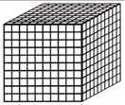
Thousands
Hundreds
Tens
Ones

